Slide 1
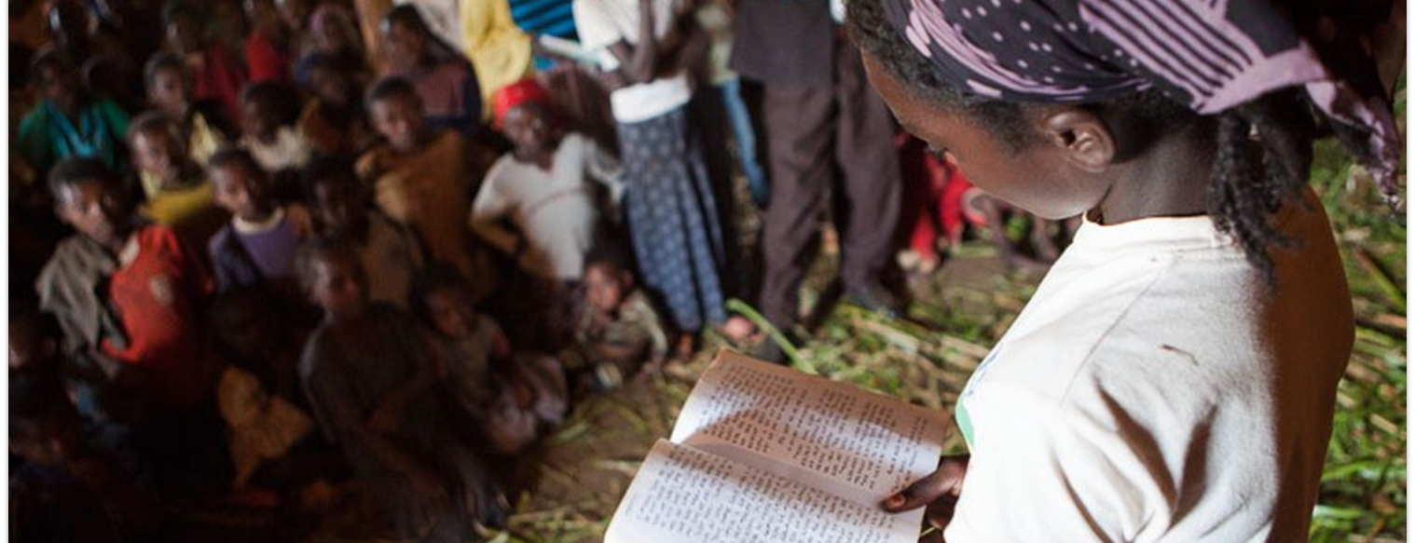
Then those who feared the LORD spoke to one another, and the LORD listened and heard them; so a book of remembrance was written before Him for those who fear the LORD and who meditate on His name (Mal. 3:16).
How then shall they call on Him in whom they have not believed? And how shall they believe in Him of whom they have not heard? And how shall they hear without a preacher? And how shall they preach unless they are sent? As it is written… (Rom. 10:14-15a).
All Scripture is taken from the New King James Version®. © 1982 by Thomas Nelson, Inc. Used by permission. All rights reserved.
Oral and Written Translation

Slide 2

Genesis 11:1–9
Genesis 11:1–9

Slide 3

Over 3000 language groups
do not use
a complete written form
Over half the languages
with no
Scripture
Completely
Oral
Completely
Written

Slide 4
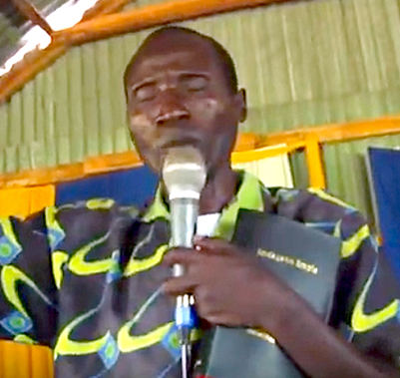
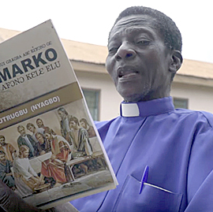
Differences in Oral Communities
Some Oral Communities
Other Oral Communities
Use and respect oral communication
Prefer to communicate important information orally
Value oral communication
Use oral and written communication
Prefer important information to be written
Value written communication

Slide 5
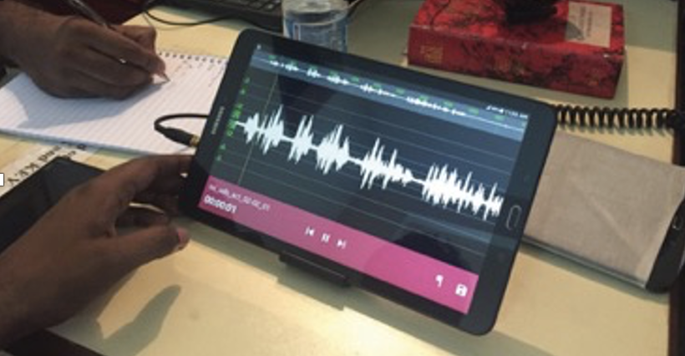
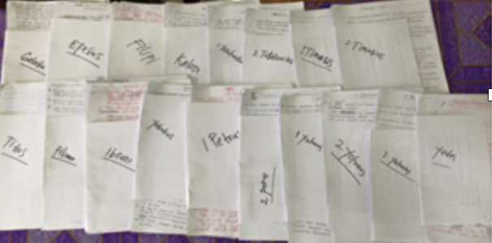
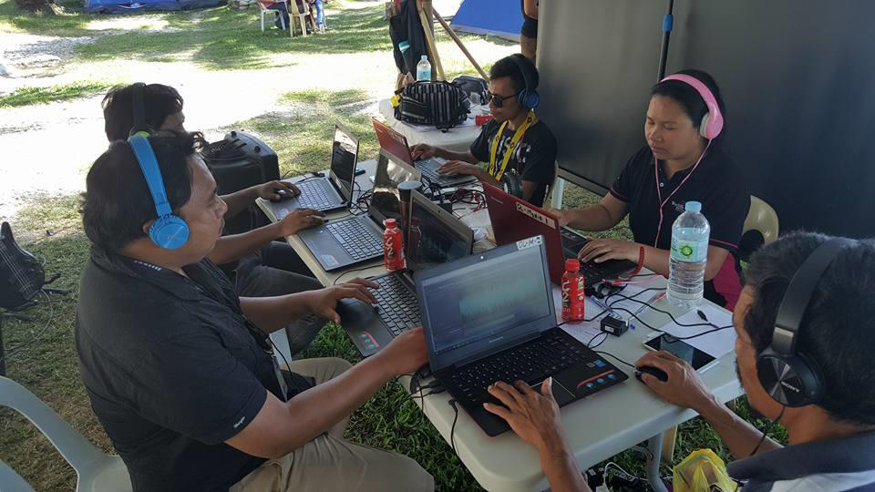

Written Translation
Oral Translation

Slide 6
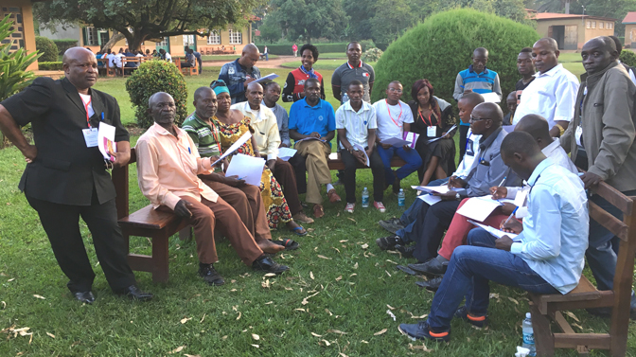

Who Decides?
Local Church
The believers in the community who are invested in getting Scripture for their heart language.

Slide 7
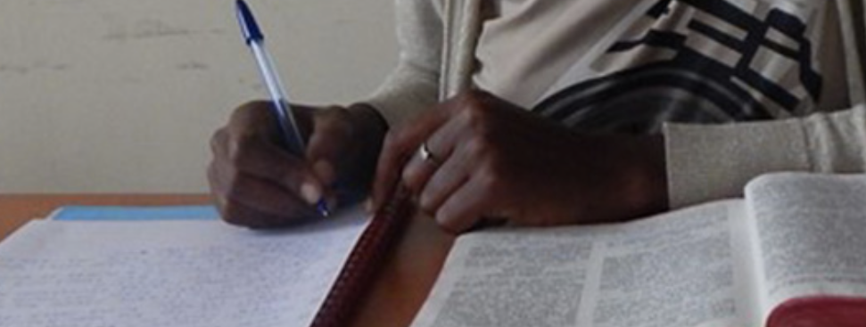
What Should the Church Consider?
Written Translation
Has there been a written language for a long time?
Does the language group have other literature?
Do the people read and write in their heart language?
Is that common?
Is the number of readers growing?

Slide 8
What Should the Church Consider?
Oral Translation
How could people listen to an oral translation?
What do they prefer?
Is literacy wanted?
Are translators able to read the source language?

Slide 9
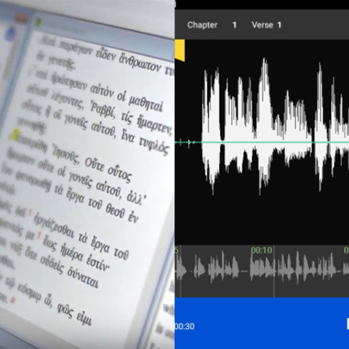
What Are Options for Translation?
If there is a writing system
Translate in writing
OR
Translate in writing and record an audio for non-readers
If there is no commonly used writing system
Translate by speaking and produce an oral translation

